Slide 1
THE VESSELS / SHIPS

Slide 2
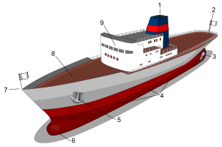
Main parts of a ship
1: Funnel ; 2: Stern ; 3: Propeller; 4: Portside ; 5: Anchor ; 6: Bulbous bow ; 7: Bow; 8: Deck ; 9: Superstructure

Slide 3
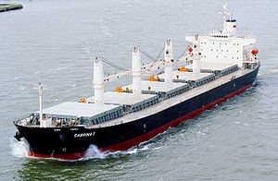
Bulk carriers are cargo ships used to transport bulk cargo: ore or food (rice, grain, etc.) and similar cargo. It can be recognized by the large box-like hatches on its deck.
The Sabrina I is a modern bulk carrier

Slide 4
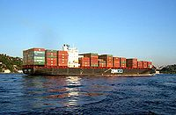
Container ships (informally known as "box boats“) are cargo ships that carry their load in containers.
ZIM Container ship in Istanbul

Slide 5
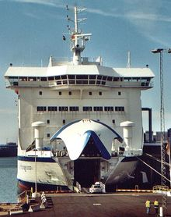
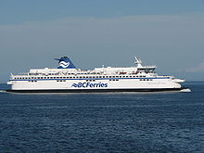
Roll-on/roll-off (RO-RO) ships are vessels designed to carry wheeled cargo: automobiles, trailers or railroad cars that are driven on and off the ship on their own wheels.
Loading a Ro-Ro passenger car Canadian RORO ferry

Slide 6
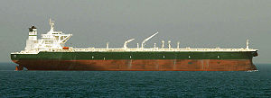
Tankers are cargo ships. They are designed to carry liquids in bulk (crude oil, petroleum products, liquefied gas, and chemicals, also wine and other food).
Commercial crude oil supertanker AbQaiq.

Slide 7

Reefer ships are cargo ships typically used to transport perishable commodities which require temperature-controlled transportation, mostly fruits, meat, fish, vegetables, dairy products and other foodstuffs.

Slide 8
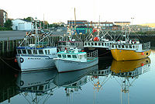
Coastal trading vessels, also known as coasters, are shallow-hulled ships used for trade between locations on the same island or continent.

Slide 9
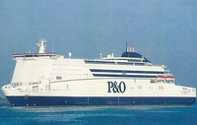
Ferries are a form of transport carrying passengers and sometimes their vehicles. Ferries are also used to transport railroad cars. Ferries form a part of the public transport systems of many waterside cities and islands, allowing direct transit much lower than bridges or tunnels.

Slide 10
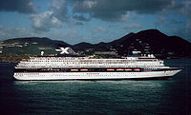
Cruise ships are passenger ships used for pleasure voyages. Cruising has become a major part of the tourism industry, with millions of passengers each year.

Slide 11
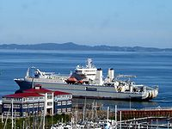
Cable layer is a deep-sea vessel designed and used to lay underwater cables for telecommunications, electricity, and such.

Slide 12
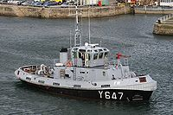
A tugboat is a boat used to push other vessels in harbours, over the open sea or through rivers and canals. They are also used to tow barges, disabled ships, or other equipment like towboats.

Slide 13
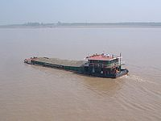
A barge is a boat, built mainly for river and canal transport of heavy goods. Most barges are not self-propelled and need to be moved by tugboats.

